Slide 1




Development of master curricula for natural disasters risk management in Western Balkan countries
Natural disasters in Bosnia and Herzegovina
Assistant Professor Naida Ademović
University of Sarajevo, Bosnia and Herzegovina
Workshop on master curricula best practices in EU partners
5th – 7th April 2017
Project number: 573806-EPP-1-2016-1-RS-EPPKA2-CBHE-JP
"This project has been funded with support from the European Commission. This publication reflects the views only of the author, and the Commission cannot be held responsible for any use which may be made of the information contained therein"

Slide 2
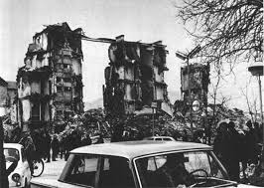
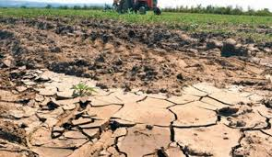
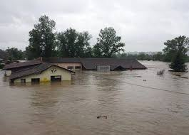
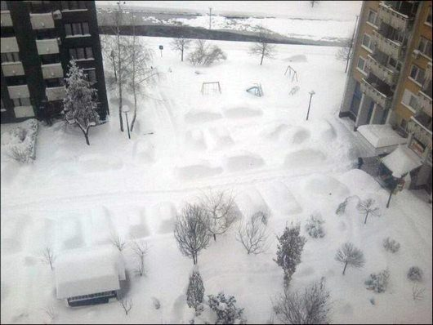
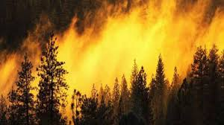
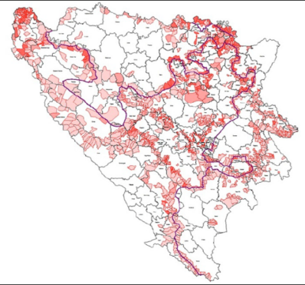
Development of master curricula for natural disasters risk management in Western Balkan countries
WP 1.1 – Identification of natural disasters - Bosnia and Herzegovina
Earthquakes
Landslides
Drought
Floods
Snow blizzards
Mines
Wild Fires

Slide 3
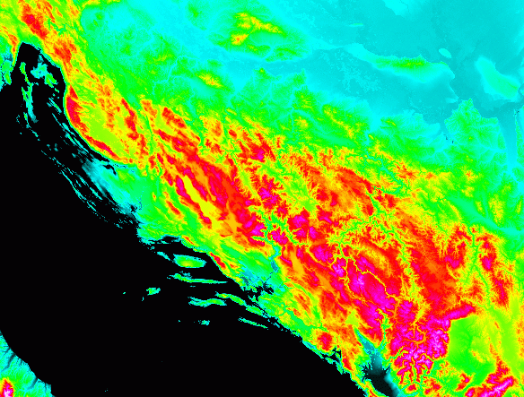
Development of master curricula for natural disasters risk management in Western Balkan countries
WP 1.1 – Landslides
Topographic characteristics
Hydrogeological characteristics
83% hills
Torrential rainfall
Landslides

Slide 4
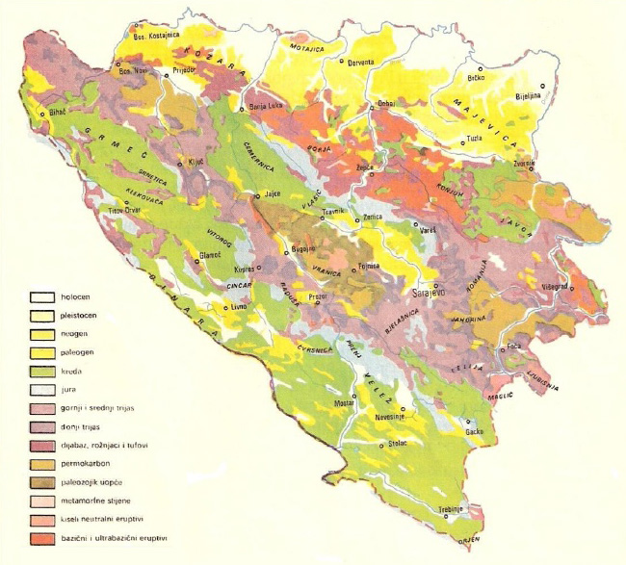
Development of master curricula for natural disasters risk management in Western Balkan countries
WP 1.1 – Landslides
Geology
Topsoils
Underlaying bedrocks
Shallow Landslides
“earth slide” or “earth flow”

Slide 5
Development of master curricula for natural disasters risk management in Western Balkan countries
WP 1.1 – Landslides
Shallow Landslides
“earth slide”
Typical shallow „earth slide“ in B&H, creep movement is evident
Typical shallow „earth slide“ observed after heavy rainfall

Slide 6
Development of master curricula for natural disasters risk management in Western Balkan countries
WP 1.1 – Landslides
Shallow Landslides
“earth flow”
5,841 triggered landslides in May floods
Typical „earth flow“ recorded during heavy rainfall events in May 2014

Slide 7
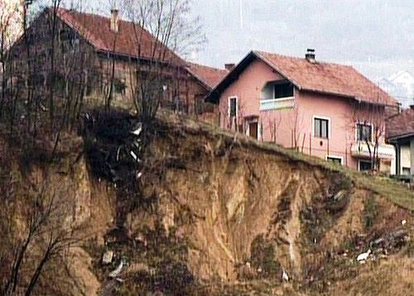
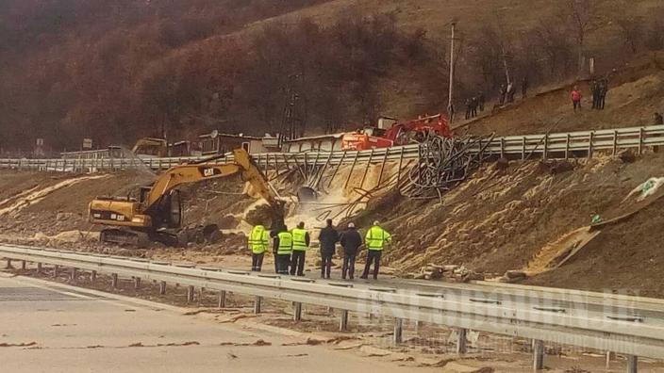
Development of master curricula for natural disasters risk management in Western Balkan countries
WP 1.1 – Landslides
Human factors
Illegal construction of houses
Lack of spatial planning documentation based on geological analysis
Unscientific mining
Hazardous construction of roads
Etc.

Slide 8
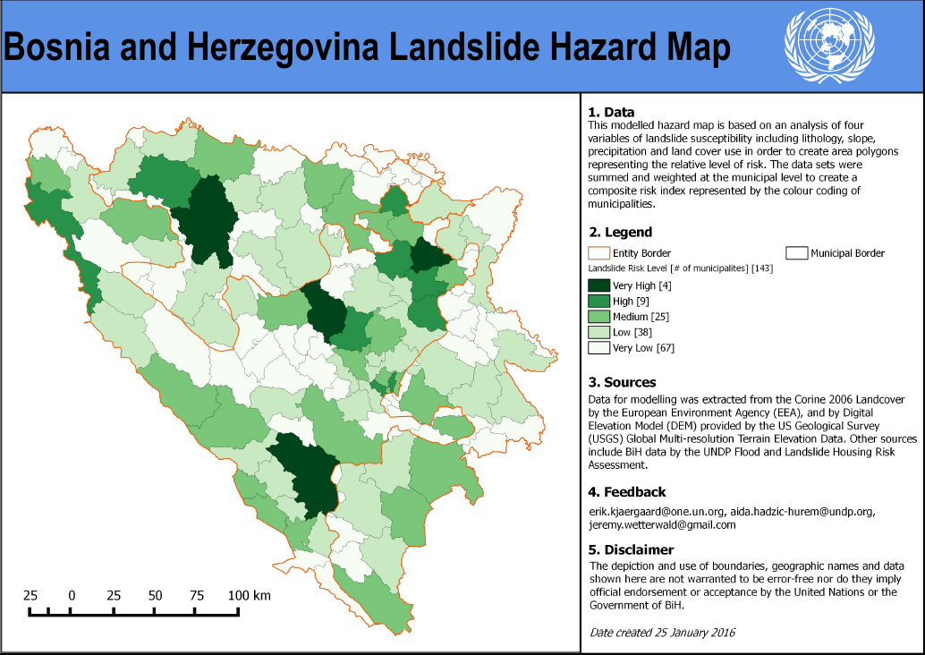
Development of master curricula for natural disasters risk management in Western Balkan countries
WP 1.1 – Landslides

Slide 9
Development of master curricula for natural disasters risk management in Western Balkan countries
WP 1.1 – Earthquakes

Slide 10
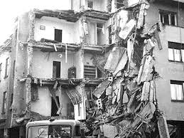
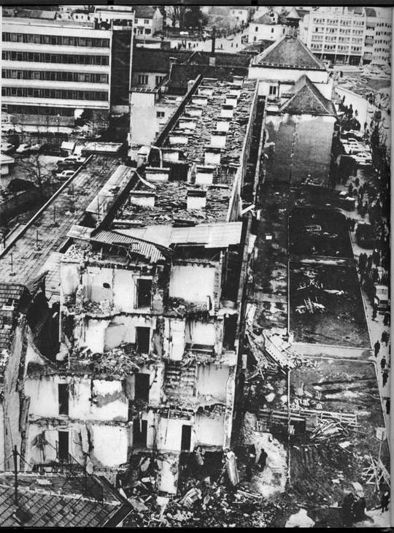
Development of master curricula for natural disasters risk management in Western Balkan countries
WP 1.1 – Earthquakes
Treskavica, near Sarajevo 11.06.1962 M=6.0
Banja Luka, (1888., 1935., 1969. i 1981) 1888 M=5.7; 1969, M=6.6
  15 casualties and 1117 people have been severely injured
  $ Mill 50.000

Slide 11
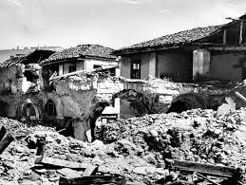
Development of master curricula for natural disasters risk management in Western Balkan countries
WP 1.1 – Earthquakes

Slide 12
Development of master curricula for natural disasters risk management in Western Balkan countries
WP 1.1 – Earthquakes
Recent
  Zenica 28.07.2012. M=4.6, focal depth 2km, next one M=4.2 focal depth 12km
  Banja Luka 29.04.2014. M=4.3, focal depth 2km
Shallow earthquakes

Slide 13
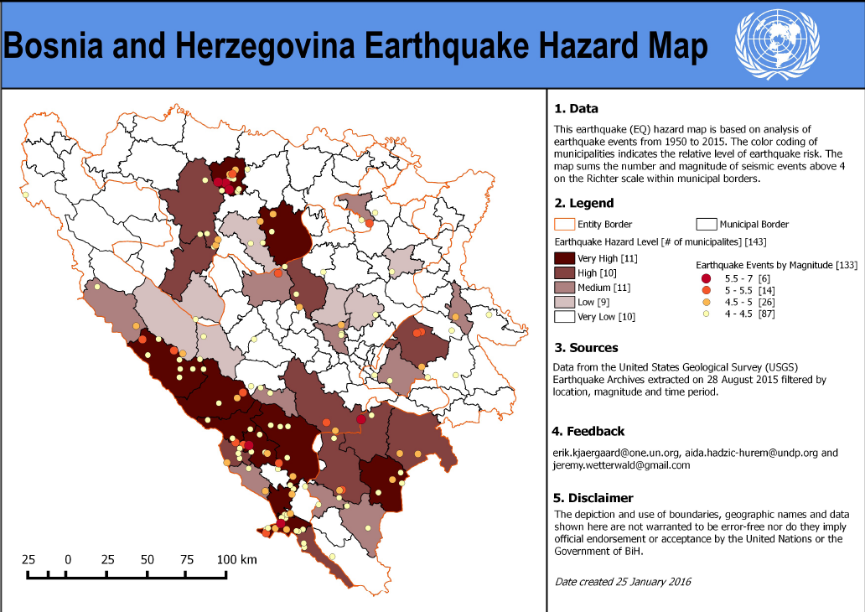
Development of master curricula for natural disasters risk management in Western Balkan countries
WP 1.1 – Earthquakes

Slide 14
Development of master curricula for natural disasters risk management in Western Balkan countries
WP 1.1 – Floods
1250 l/m² annually (64x106 m³ of percipitation)
annual swell=
57% (total perc)
Sava River Basin (62.3%)
River Basin Neretva (37.5%)
Rich in water
Extremely uneven
Adriatic Sea
time+space
Black Sea

Slide 15
Development of master curricula for natural disasters risk management in Western Balkan countries
WP 1.1 – Floods
B&H exposed to high risk flooding
Damage
Economy
Infrastructure facilities
Health
Loss of human lives

Slide 16
Development of master curricula for natural disasters risk management in Western Balkan countries
WP 1.1 – Floods
Floods in 2001
Damage to: agriculture, road infrastructure, buildings
River Una

Slide 17
Development of master curricula for natural disasters risk management in Western Balkan countries
WP 1.1 – Floods
Floods in 2004 (March and April)
135,000 ha of agricultural land affected by floods
Loss of 13 million Euros

Slide 18
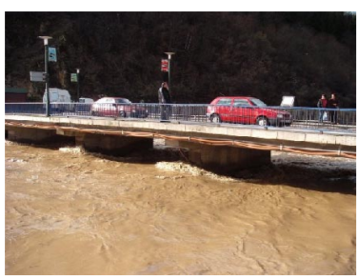
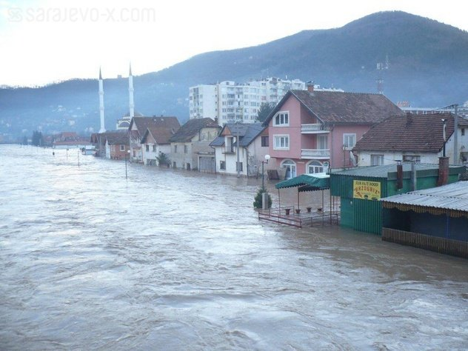
Development of master curricula for natural disasters risk management in Western Balkan countries
WP 1.1 – Floods
Floods in 2010
Overall losses 44 million Euros
River Bosnia

Slide 19
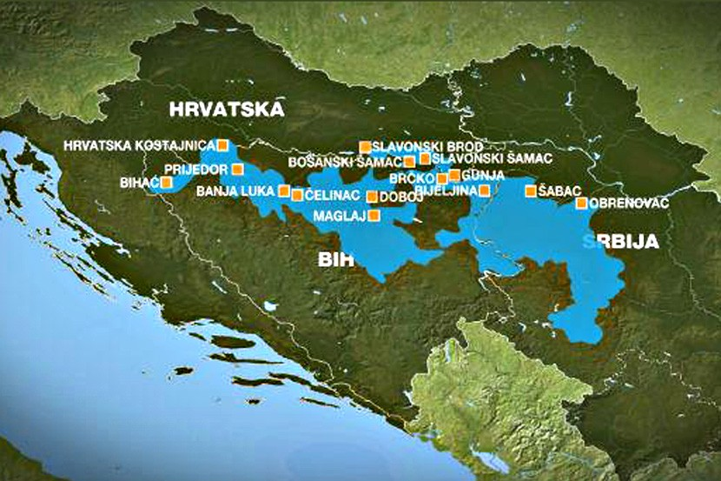
Development of master curricula for natural disasters risk management in Western Balkan countries
WP 1.1 – Floods
Floods in 2014
Catastrophic scenario

Slide 20
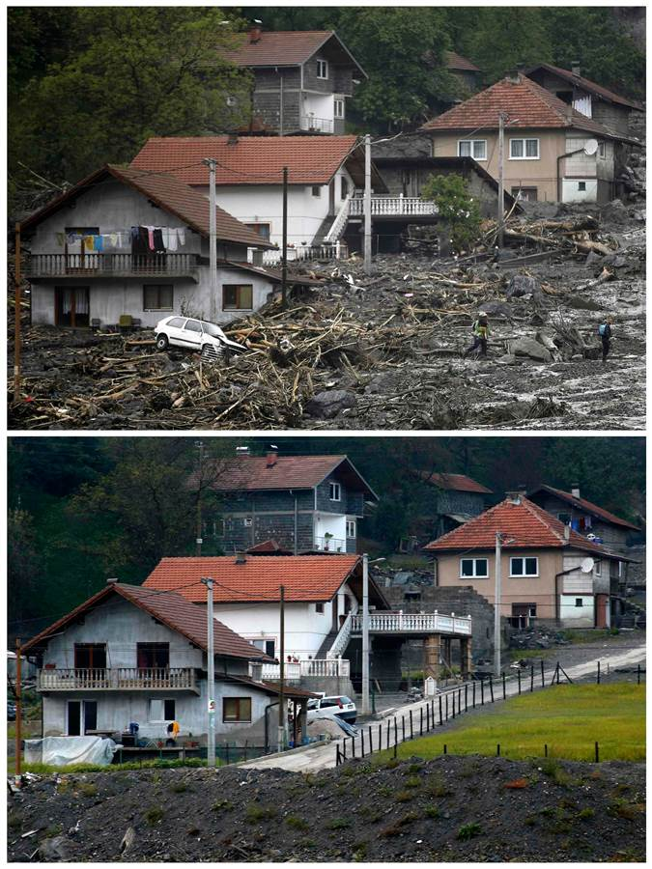
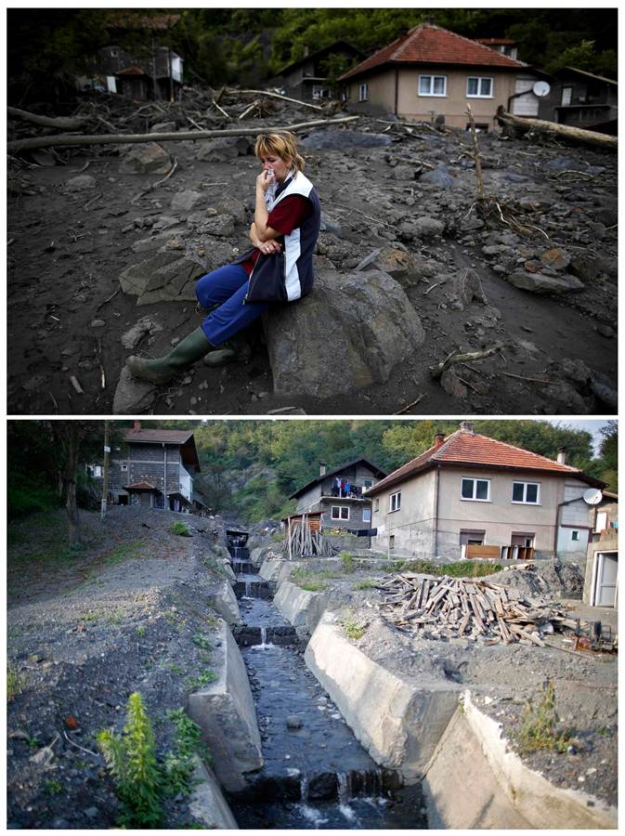
Development of master curricula for natural disasters risk management in Western Balkan countries
WP 1.1 – Floods
Floods in 2014
Catastrophic scenario

Slide 21
Development of master curricula for natural disasters risk management in Western Balkan countries
WP 1.1 – Floods
Floods in 2014 Loss 2.00 billion Euros
Storm + rain
Overcame the record in the last 120 years
BOSNA+SAVA+DRINA RIVERS and their tributaires
Landslides
14,415 damaged residential buildings
1,030 demolished residential buildings
30,478 ha agriculural land

Slide 22
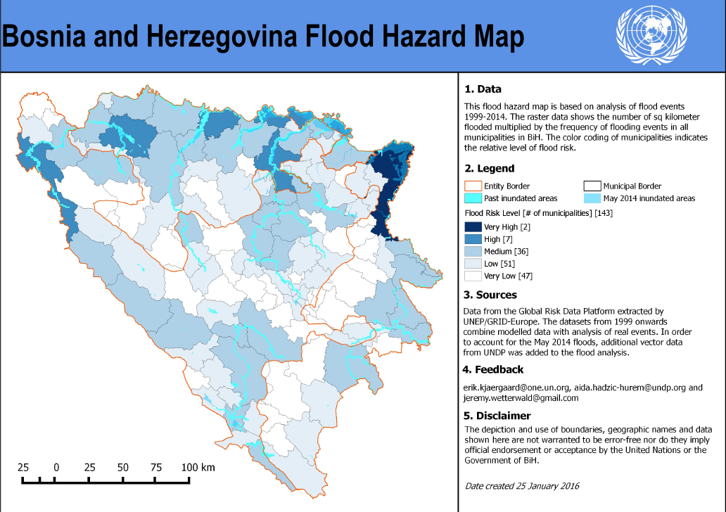
Development of master curricula for natural disasters risk management in Western Balkan countries
WP 1.1 – Floods

Slide 23
Development of master curricula for natural disasters risk management in Western Balkan countries
WP 1.1 – Wild Fires
Direct damages include loss of timber supplies, terrestrial vegetation and other forest products, and the cost of extinguishing the fire and rehabilitation.
Indirect damage includes a negative impact on beneficial functions of forests and is determined in a relative manner.

Slide 24
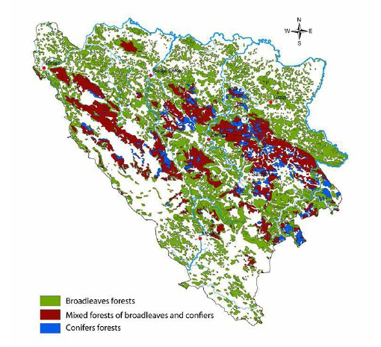
Development of master curricula for natural disasters risk management in Western Balkan countries
WP 1.1 – Wild Fires
Distribution of forests in Bosnia and Herzegovina

Slide 25
Development of master curricula for natural disasters risk management in Western Balkan countries
WP 1.1 – Wild Fires

Slide 26
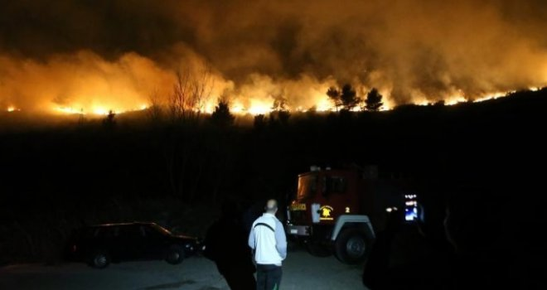
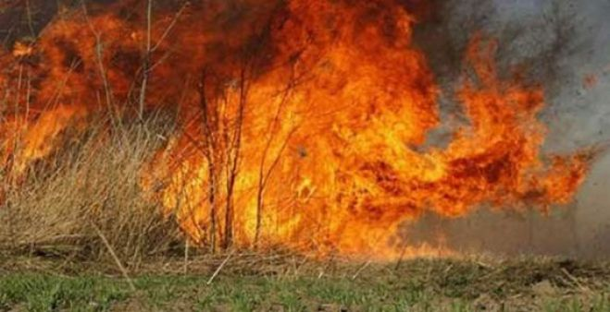
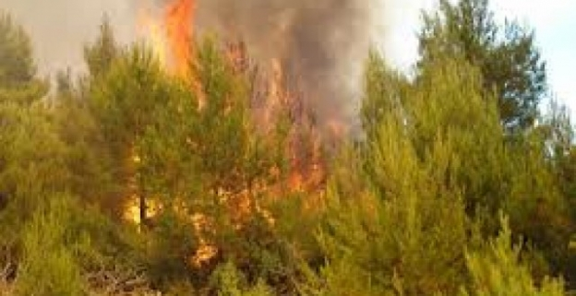
Development of master curricula for natural disasters risk management in Western Balkan countries
WP 1.1 – Wild Fires

Slide 27
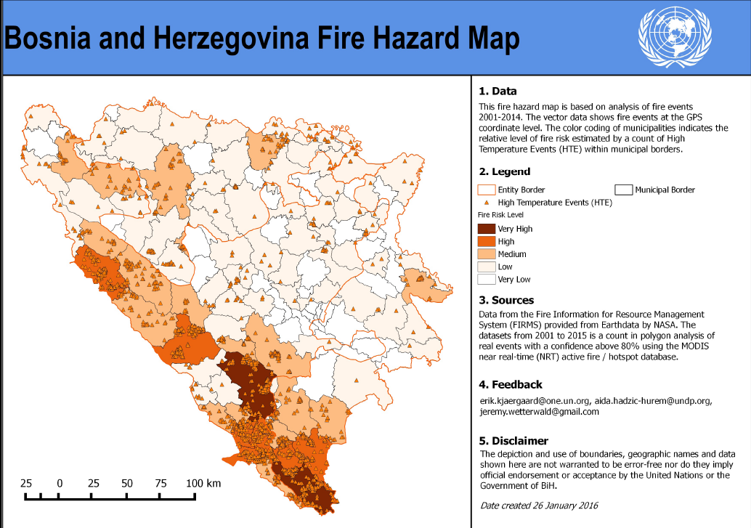
Development of master curricula for natural disasters risk management in Western Balkan countries
WP 1.1 – Wild Fires

Slide 28
Development of master curricula for natural disasters risk management in Western Balkan countries
WP 1.1 – Drought
Damage
Economy
Agriculture
Food production

Slide 29
Development of master curricula for natural disasters risk management in Western Balkan countries
WP 1.1 – Drought
Drought
Quality of water shortage in the soil in mm
Potential evapotranspiration (SET/PET)
Coefficient of drought
Frequency of droughts

Slide 30
Development of master curricula for natural disasters risk management in Western Balkan countries
WP 1.1 – Drought
Northeast and southwest of B&H
7 extremely dry period in the last 50 years
Strongest droughts in Mostar area (1952)

Slide 31
Development of master curricula for natural disasters risk management in Western Balkan countries
WP 1.1 – Drought
August 2000
  The worst drought in 120 years
  Affected 60% agricultural production = extreme food deficiency
Summer 2003
  Damage of 200 million Euros (affected 200,000 people)
Summer 2007+ high temperatures
  Destroyed 40% agricultural production
  Forest fires affected 250ha

Slide 32
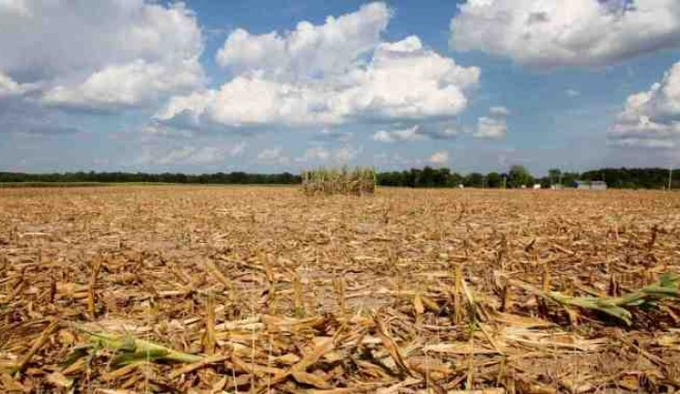
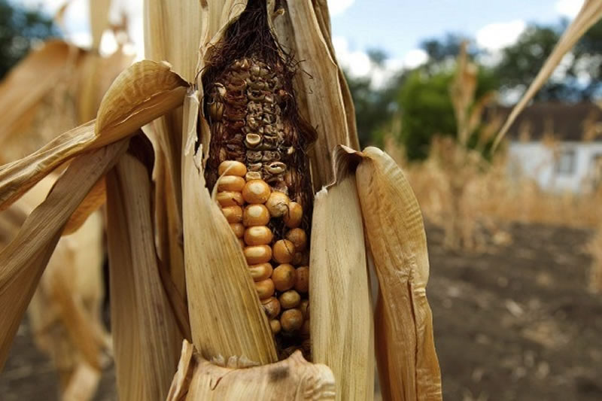
Development of master curricula for natural disasters risk management in Western Balkan countries
WP 1.1 – Drought
August 2012
  Damage of 1 billion USD in agricultural production
  70% reduced grains and vegetable yeals
  25% reduction of energy production from power plants

Slide 33
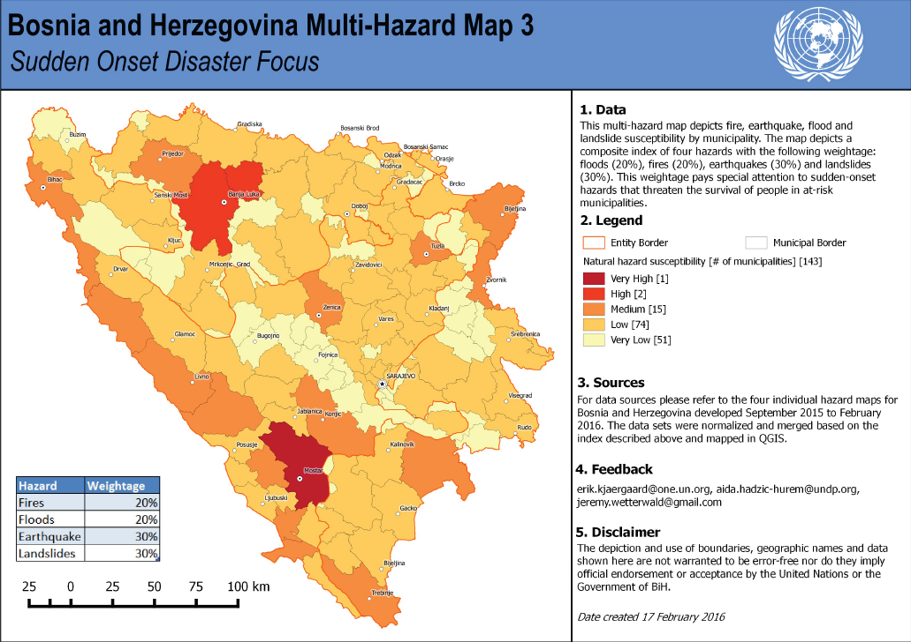
Development of master curricula for natural disasters risk management in Western Balkan countries

Slide 34
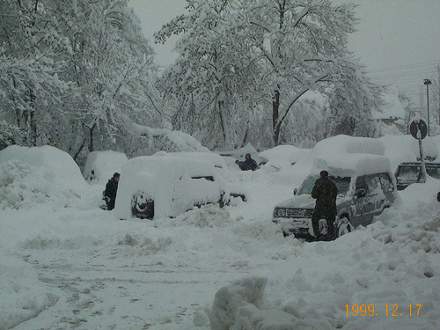
Development of master curricula for natural disasters risk management in Western Balkan countries
WP 1.1 – Blizzards and snow drifts
The number of snow days ranges from approximately seventeen to forty-one, while January is the month with the most snow days (eleven).
During the winter of 1999-2000 heavy snowfall swept most parts of the country and a state of natural disaster was declared in the northeast of Bosnia.
In 1999/2000 -100 cm of snow in 1 hour

Slide 35
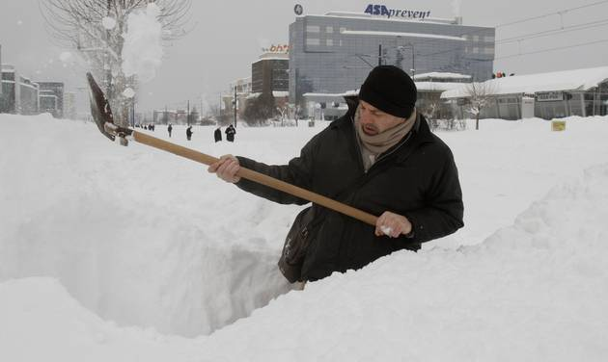
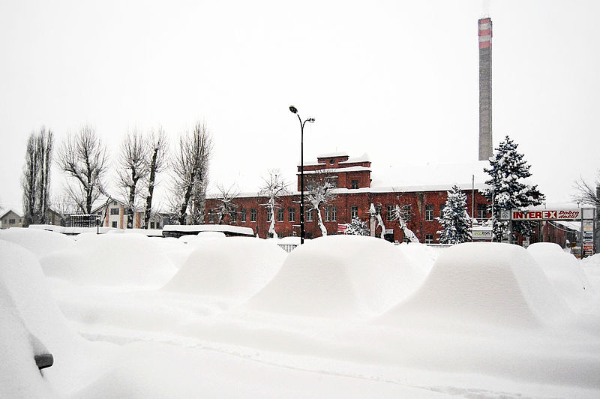
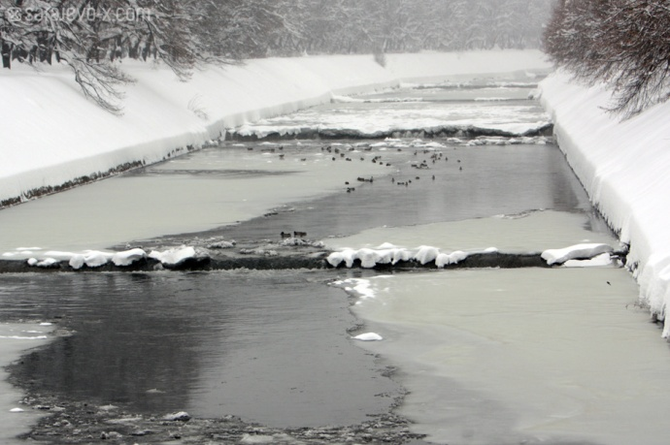
Development of master curricula for natural disasters risk management in Western Balkan countries
WP 1.1 – Blizzards and snow drifts
2012
  110 cm of snow in Sarajevo, total collapse of traffic
  State of emergency has been declared in Sarajevo after more than a meter of snow fell on the capital.
  Low temperatures
  More than 100 remote Bosnian villages are cut off by more than 2m of snowfall in the mountains.

Slide 36
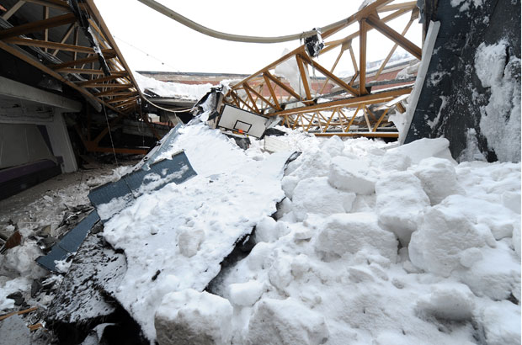
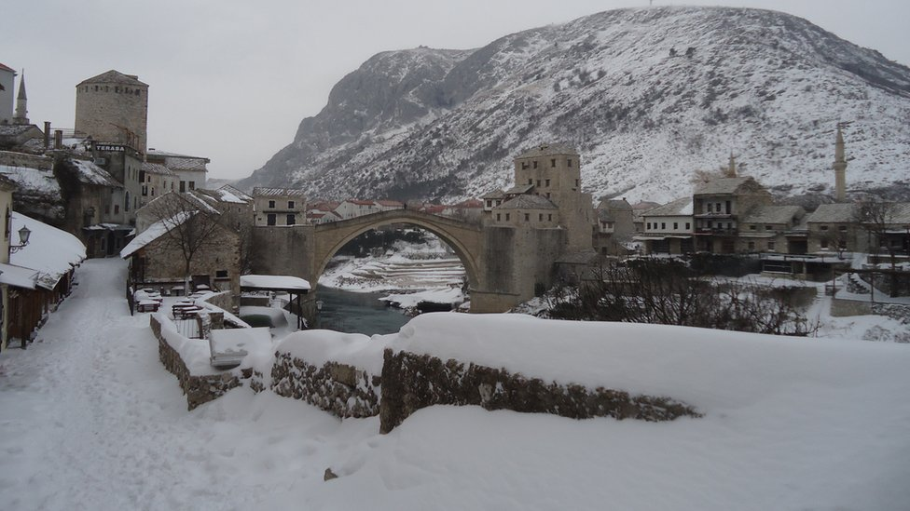
Development of master curricula for natural disasters risk management in Western Balkan countries
WP 1.1 – Blizzards and snow drifts
2012
  The roof of the Olympic sports hall "Skenderija" collapsed in Sarajevo, Bosnia, in February 2012 after heavy snow. No one was injured, but dozens died due to extreme weather in the Balkans that dropped 150 centimeters of snow in some areas in just a week

Slide 37
Development of master curricula for natural disasters risk management in Western Balkan countries
Risk management
Landslides
  Proper engineering is mandatory
  Construction of earthworks for slopes should comply with the relevant standard or codes
  Development of the landslide inventory system
  The rating of the landslide risk
  Development of legislation such as “Landslide Prevention Law” which governs the landslide management and risk mitigations in B&H should be implemented.
  Many landslides in B&H are triggered by rainfalls.
  There is no landslide risk matrix or risk rating system in B&H.

Slide 38
Development of master curricula for natural disasters risk management in Western Balkan countries
Risk management
Earthquakes
  Proper engineering is mandatory
  Construction of engineering structures should comply with the relevant standard or codes
  Development of the construction inventory system
  The rating of the earthquake risk of existing structures
  There is no earthquake risk matrix or risk rating system in B&H.
  -have negligible tangible assets and equipment
  -not fully equipped and are lacking professional personnel
  -it is necessary to modernize the network of seismic stations

Slide 39
Development of master curricula for natural disasters risk management in Western Balkan countries
Risk management
Floods
  Proper engineering is mandatory
  By entity laws of the Water (2006) have established two inter fully independent system of water management in B&H
  The flood protection system is still incomplete and dysfunctional, and that in future all necessary strategic and planning documents in B&H make timely coordinated, concerted, and most importantly, all to achieve an integrated national and regional flood protection system, which guarantees to citizens greater security of life and property.

Slide 40

Development of master curricula for natural disasters risk management in Western Balkan countries
Risk management
Wild fires
  Assessment of fire risk only three cantons
  Still an open issue and something that has not been completed B&H
  One of the main problems in B&H is the existence of areas contaminated by landmines

Slide 41
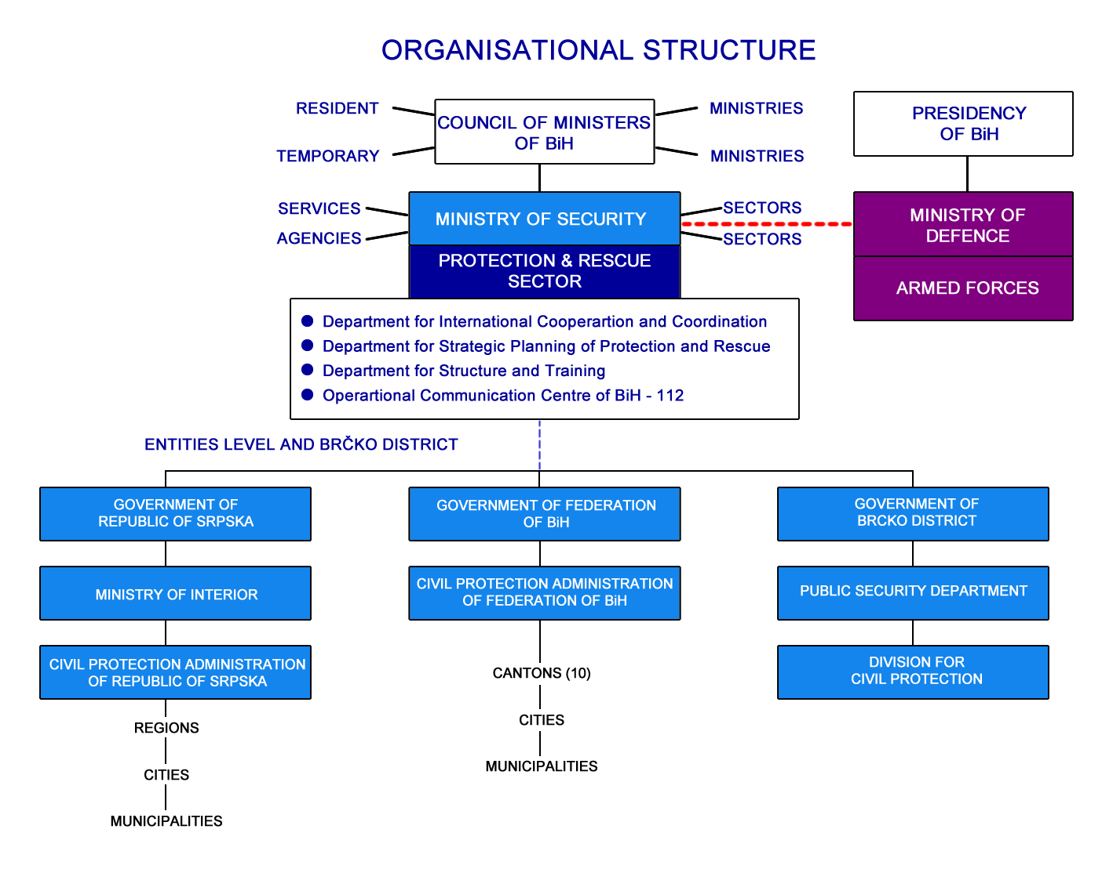
Development of master curricula for natural disasters risk management in Western Balkan countries
Responsible institutes

